Slide 1
Widescreen Test Pattern (16:9)
Aspect Ratio Test
(Should appear circular)
4x3
16x9

Slide 2


Slide 3
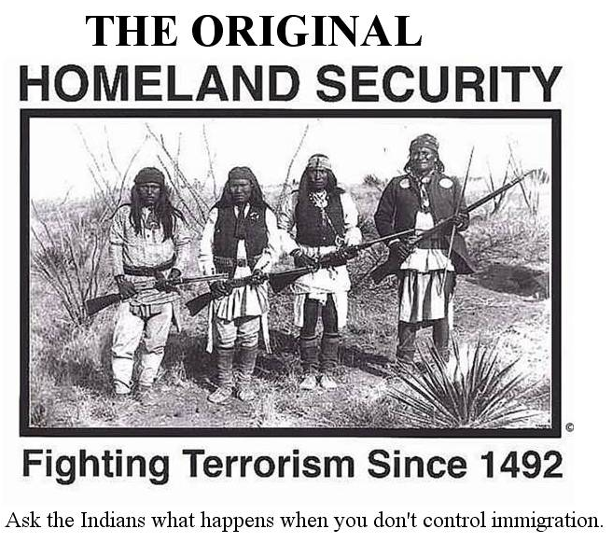

Slide 4
DXers are a special kind of radio amateur
#1 Honor Roll DXCC
  DXCC Challenge (Clinton B. DeSota Cup)
  160M & 6M
  All modes from expeditions
Worked All Zones
It’s a complicated, long game.

Slide 5

Club Log :: www.clublog.org
Presented by K8ZTT

Slide 6
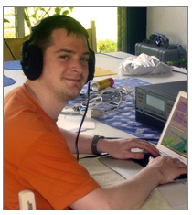

MICHAEL g7vJR
Author of Club Log

Slide 7
Ham radio on the web
Many ham radio sites existed already in 2007:
Logbook Of The World
eQSL
RSGB IOTA
SOTA etc
Each serves a special purpose.
Michael wanted to create something for DXers. It had to be…
Useful, insightful and interesting
Easy and attractive to use
Fast, no matter what
Accurate and credible
Free to all & no advertising

Slide 8
How we’re doing
The following details are refreshed once a week. As of 22nd June, 2013:
There are 124 clubs, 18,888 users and 24,678 callsigns registered in Club Log.
Each day, an average of 580 new logs are uploaded.
Club Log Statistics
There are 167.9 million log entries available for analysis, making the average log size 6,803 QSOs.
36% of QSOs stored in Club Log are confirmed with a QSL (including LoTW claims).

Slide 9
Why Bother?
EXCELLENT
RESOURCE FOR ALL
Notes:
Club Log has a deafault mapping based upon the most likely mapping, eg GB-England.
Some logging software seems to base it’s mapping on the least likely mapping!

Slide 10
By uploading your log you will receive:
Personal DXCC reports and league tables
Detailed analysis of your log, using researched DXCC information
Zone charts for your log, again based on detailed research
A personal timeline of your activity (DXCCs per year, band and mode info)
Your own log search tool, eg. to link from your web page or QRZ profile
A filtered DX Cluster which only tells you about DX you still 'need'
A say in the Club Log most wanted report: your log is part of the trend data

Slide 11
By uploading your log you will receive:
Access to propagation and activity predictions, using everyone's logs.
QSL suggestions to help you send out just the cards you need.
OQRS (Online QSL Requests) to make direct and bureau QSLing faster and easier.
Satisfaction from taking part in and improving a free Dxing resource.

Slide 12
How Does it Work?
Club Log is a DXing database where your log is analysed in great depth
You upload your log…
Thousands of others do the same
Club Log becomes enriched with millions of QSOs
QSOs
Logging Software
Club Log

Slide 13
The need for accuracy
  DXing is competitive and life-long: it’s a big, complicated arena.
  The rules are very precise
  Award schemes are cherished and achieved on a level playing field
Callsigns are chaotic and often ambiguous for DXCC claims
Difficult awards are only attractive when they are credible
Without precise DXCC maps, Club Log would be of no practical use!

Slide 14
Prefixes, Date Bounds…
Prefixes
Start
End
Exceptions
Start
End
DXCC Entity
Start
End
  Hard–coded rules handle more complex cases
Notes:
Mention Michael’s special rules for some prefixes eg KC6xx vs KC6xxx & KC6x

Slide 15
Why exceptions?
Ambiguous calls
Nomadic calls
Prefix violations
E5, FO, GB, JD1, SV0, VP8
KL7XYZ in W6
ZL0ADZ/KB0
Notes:
Club Log has a deafault mapping based upon the most likely mapping, eg GB-England.
Some logging software seems to base it’s mapping on the least likely mapping!

Slide 16
Exceptions today
13,435 exceptions
3,618 prefixes
All freely available to other software developers

Slide 17
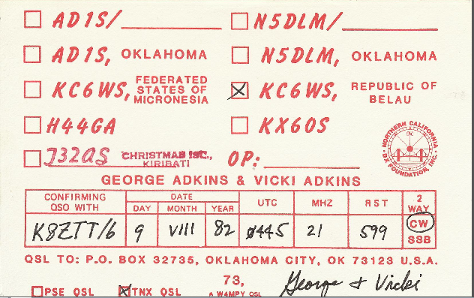
Researching exceptions
LoTW Claims
Email Threads
Google
DX News archives
QSL Cards
QRZ.COM

Slide 18
A short guided tour…

Slide 19
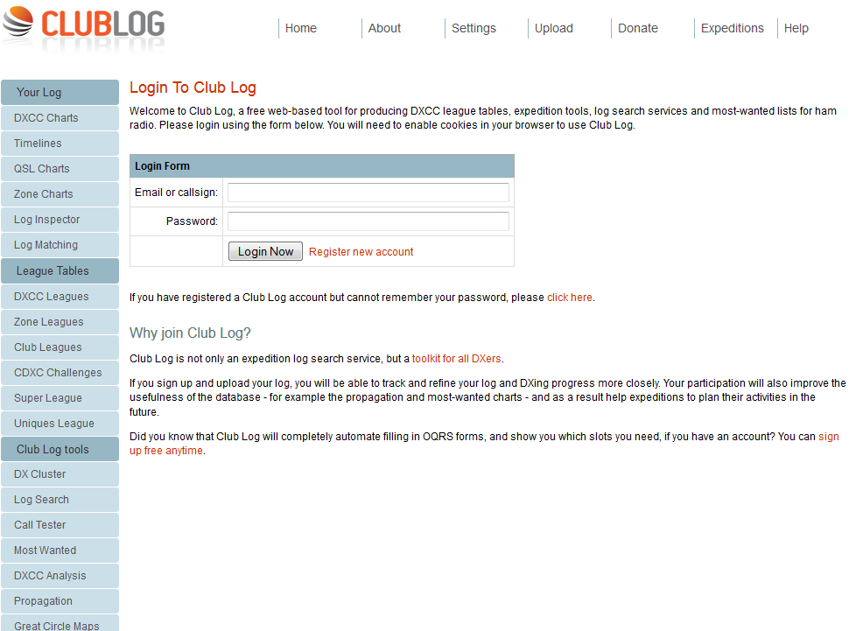
LOGIN SCREEN….

Slide 20
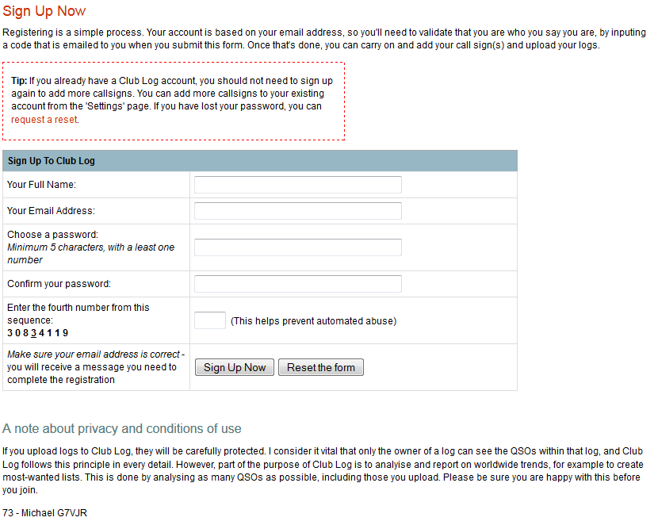
SIGNUP !!….

Slide 21
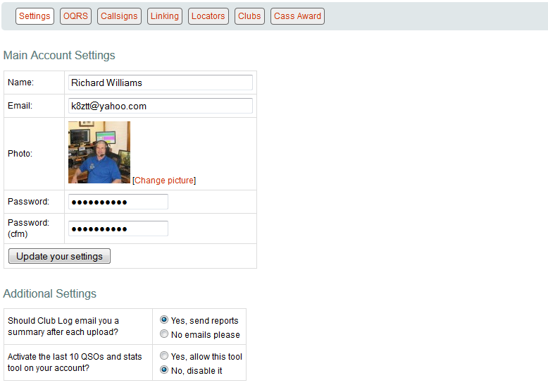
SETTINGS

Slide 22
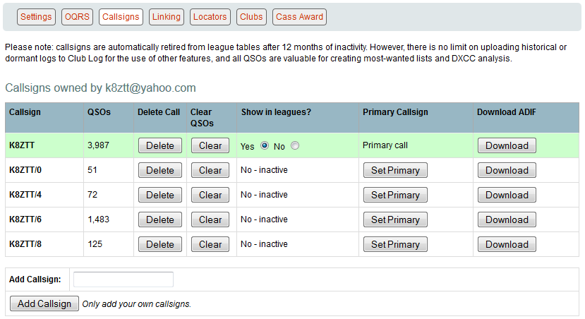
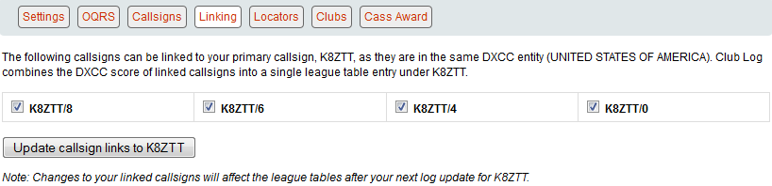
SETTINGS: Callsigns & Linking

Slide 23
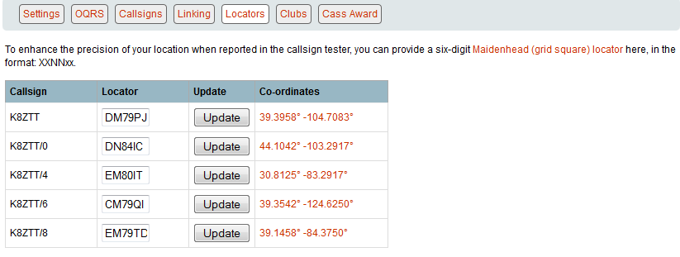
SETTINGS: Locators

Slide 24
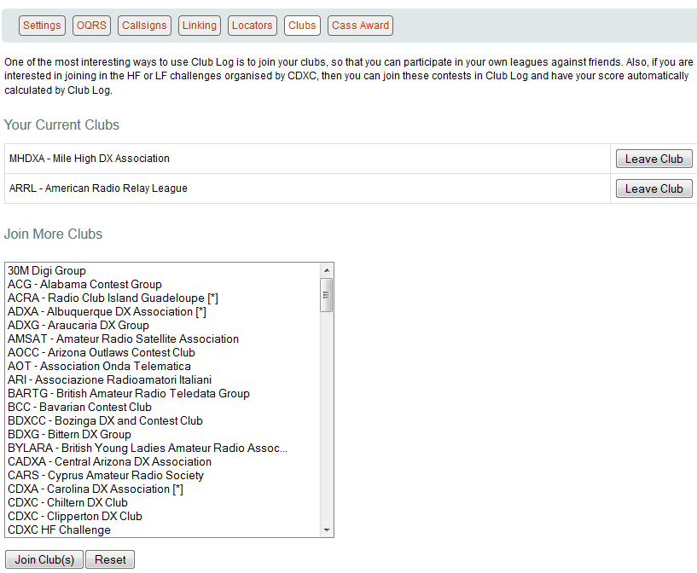
SETTING: Clubs

Slide 25
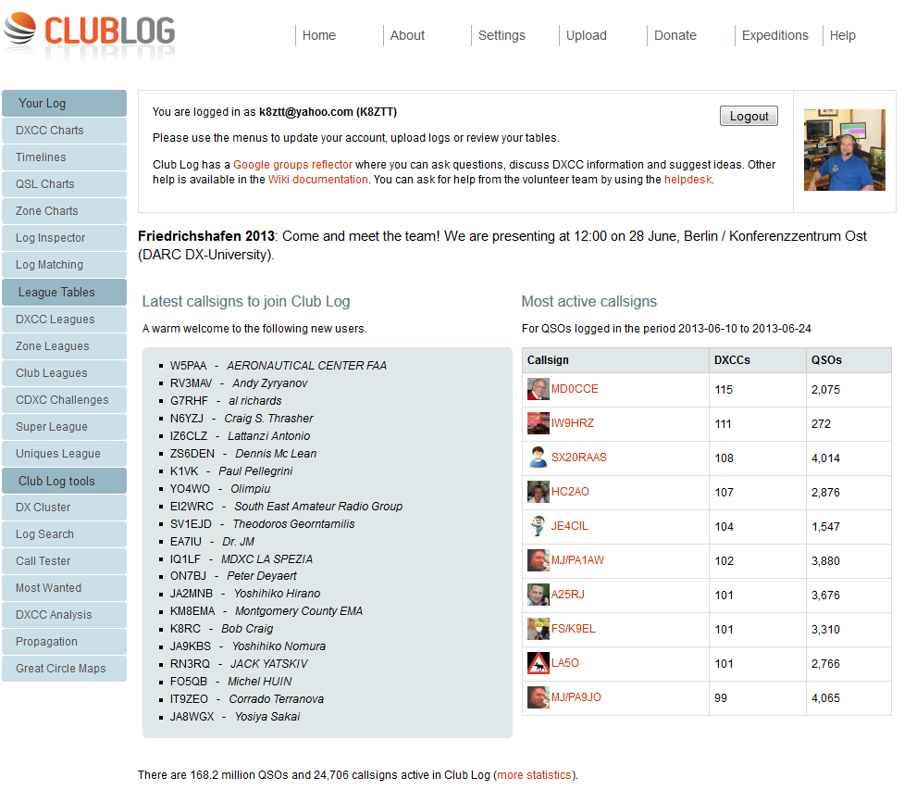
LOGGED IN !!
Notes:
Club Log has a deafault mapping based upon the most likely mapping, eg GB-England.
Some logging software seems to base it’s mapping on the least likely mapping!

Slide 26
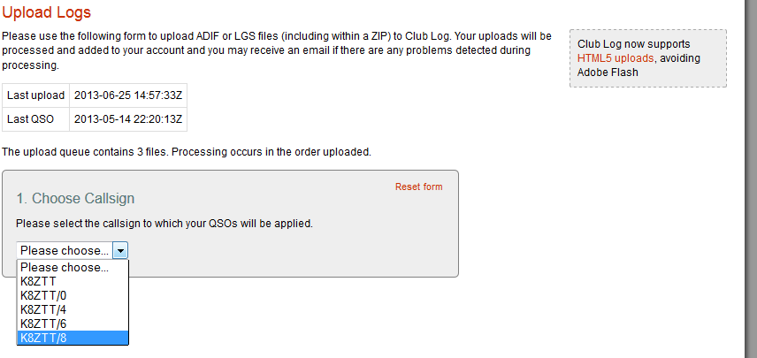
UPLOAD

Slide 27
Club Log finds ‘new ones”
K8ZTT: VP8CQS 1994 – new 80m band slot!
K7UA: P29WB 1975 - new (deleted) DXCC! - Papua Territory
PA0MIR/A: VP8KO 1969 - new DXCC! - S. Orkney

Slide 28
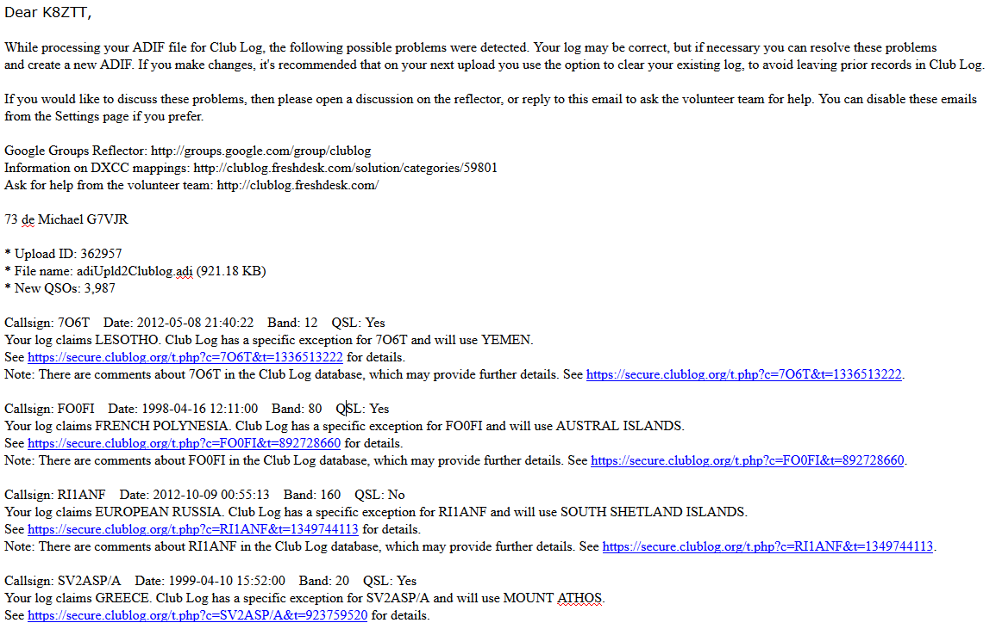
Email report on upload

Slide 29
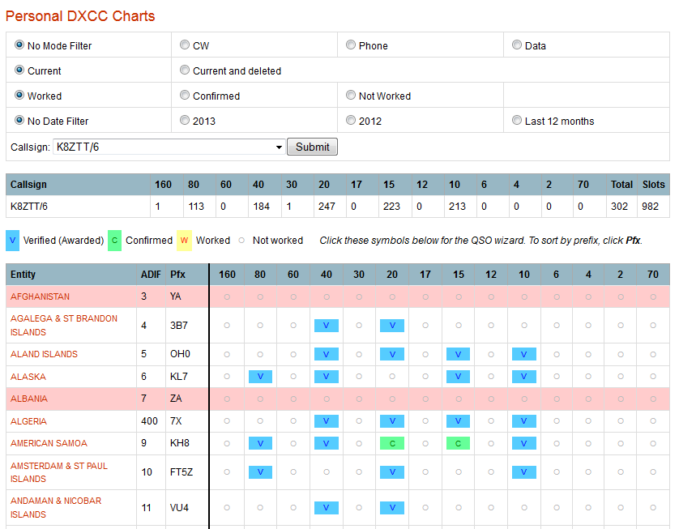
YOUR LOG: DXCC Charts

Slide 30
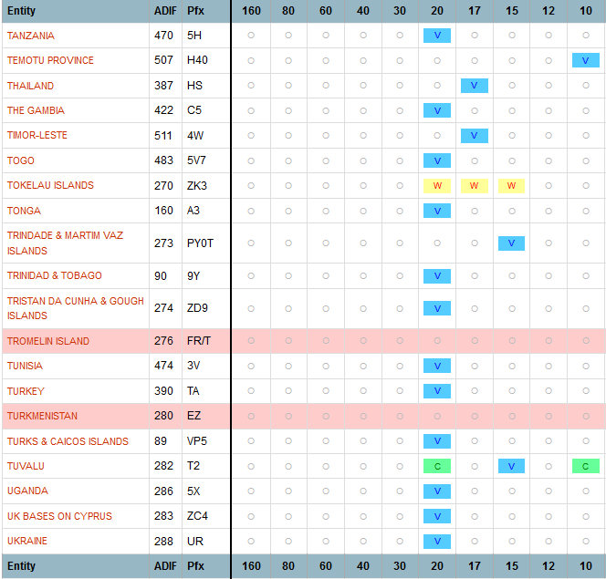
YOUR LOG: DXCC Charts

Slide 31
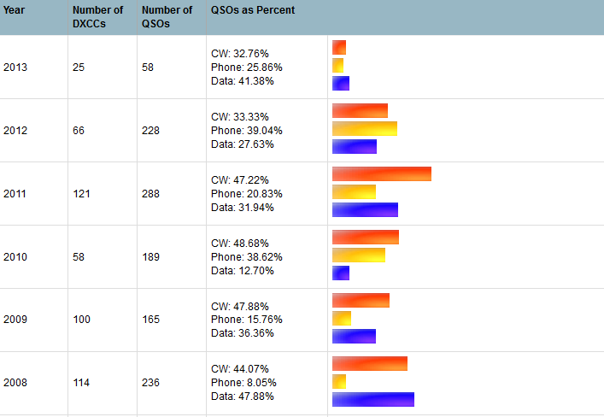
YOUR LOG: Timeline

Slide 32
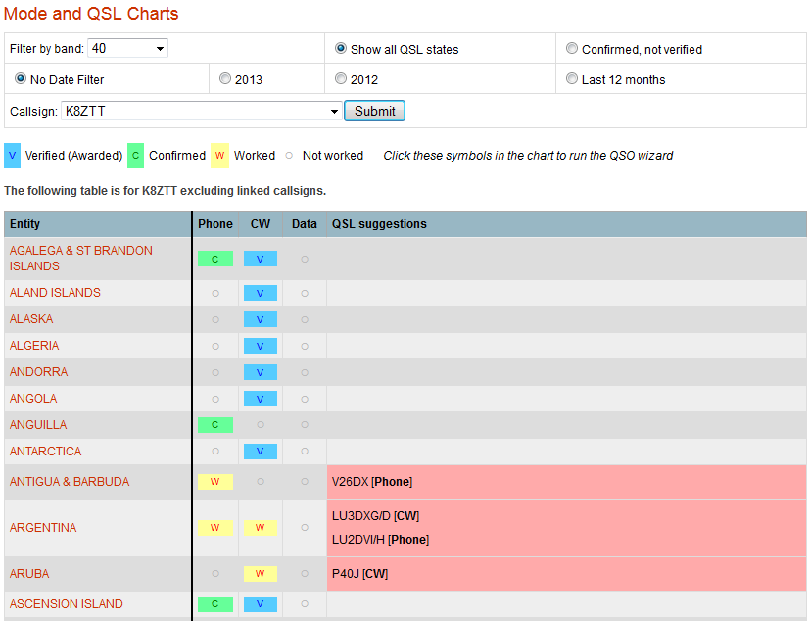
YOUR LOG: QSL Chart

Slide 33
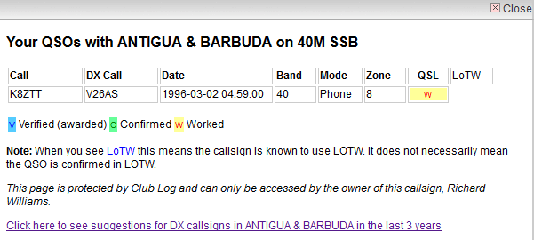
YOUR LOG: QSL Chart

Slide 34
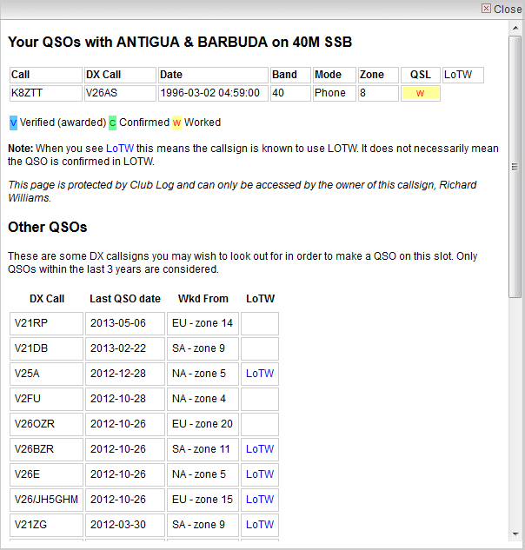
YOUR LOG: QSL Chart

Slide 35
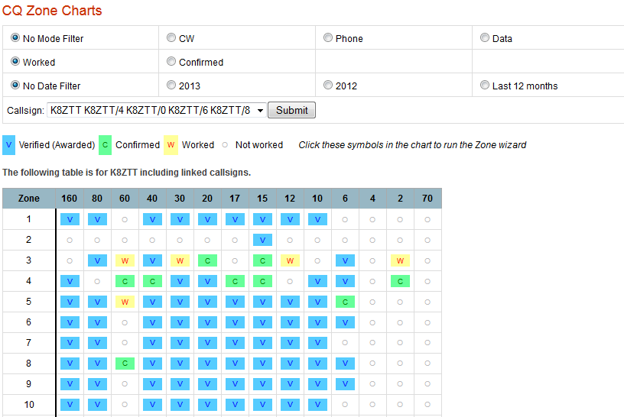
YOUR LOG: Zone Charts

Slide 36
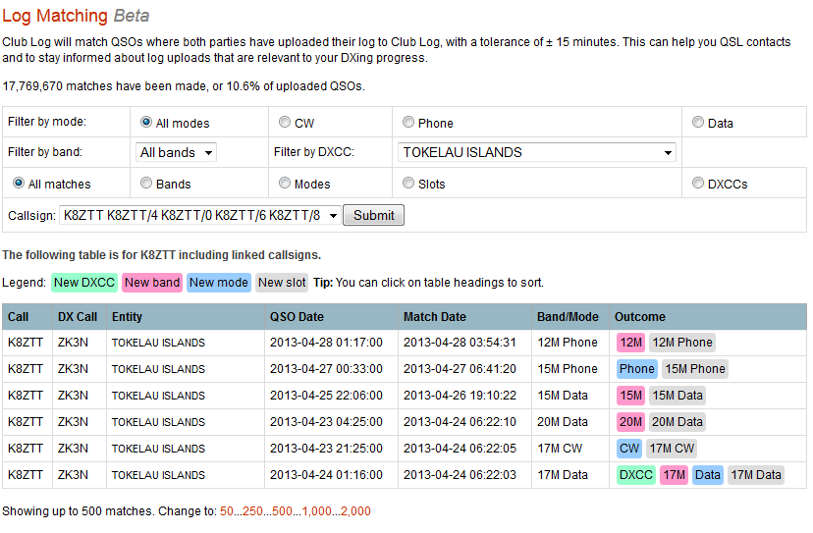
YOUR LOG: Log Matching

Slide 37
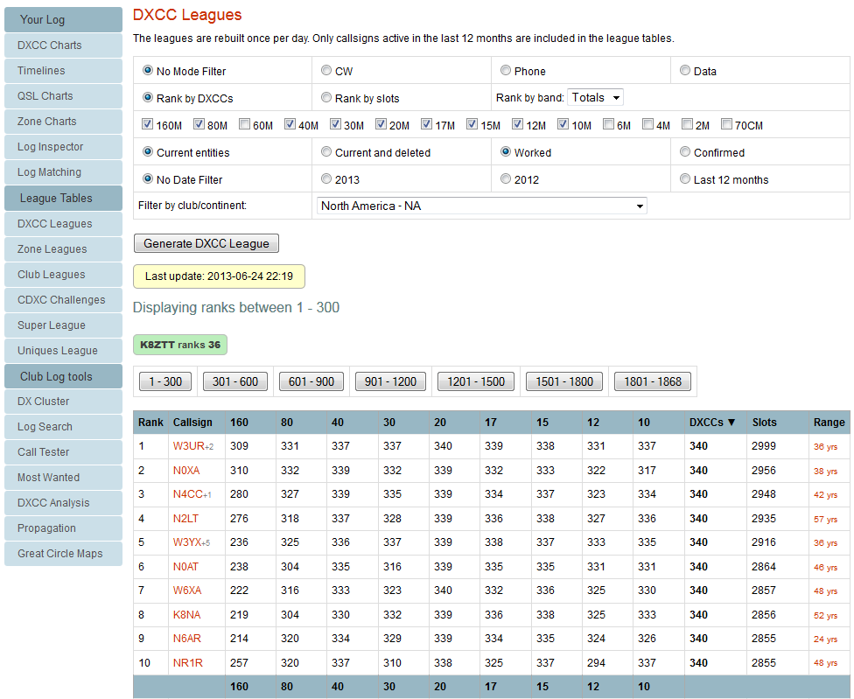
LEAGUE TABLES: DXCC

Slide 38
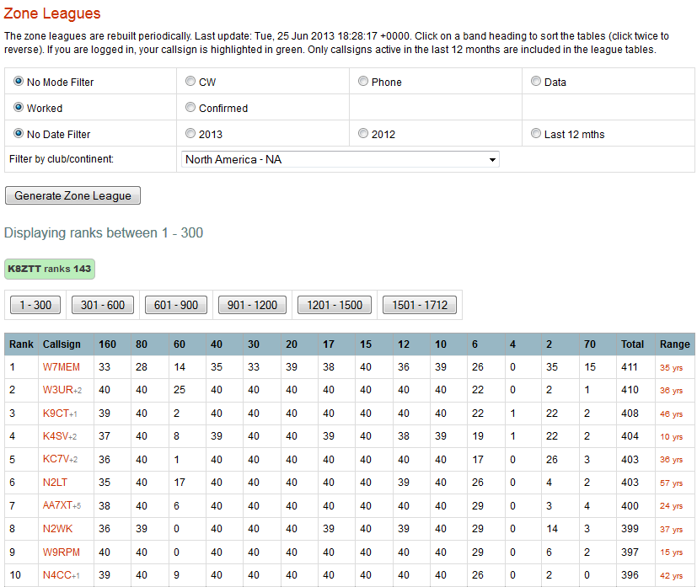
LEAGUE TABLES: Zones

Slide 39
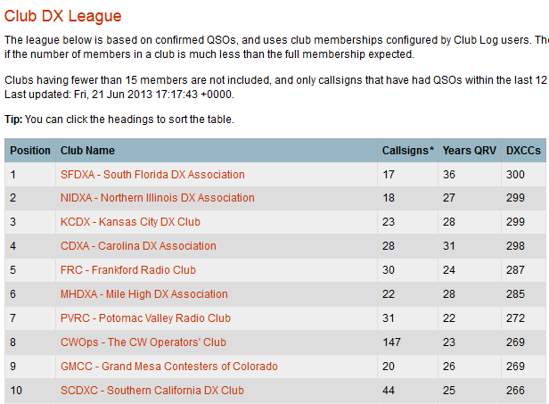
LEAGUE TABLES: Clubs

Slide 40
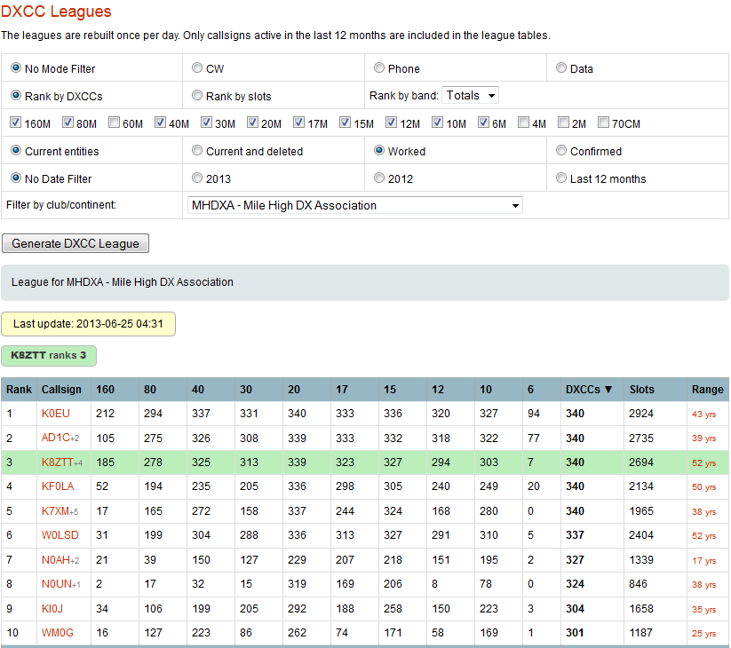
LEAGUE TABLES: DXCC

Slide 41
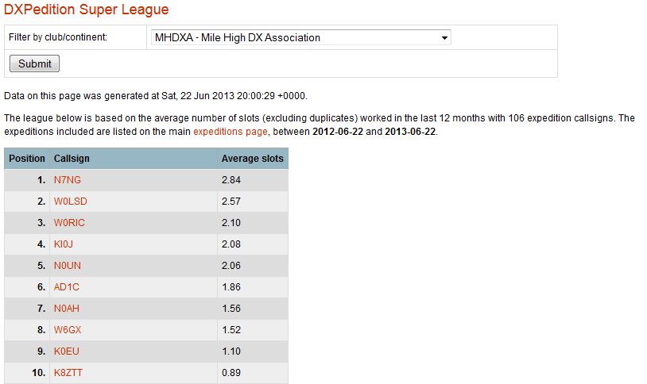
LEAGUE TABLES: Super

Slide 42
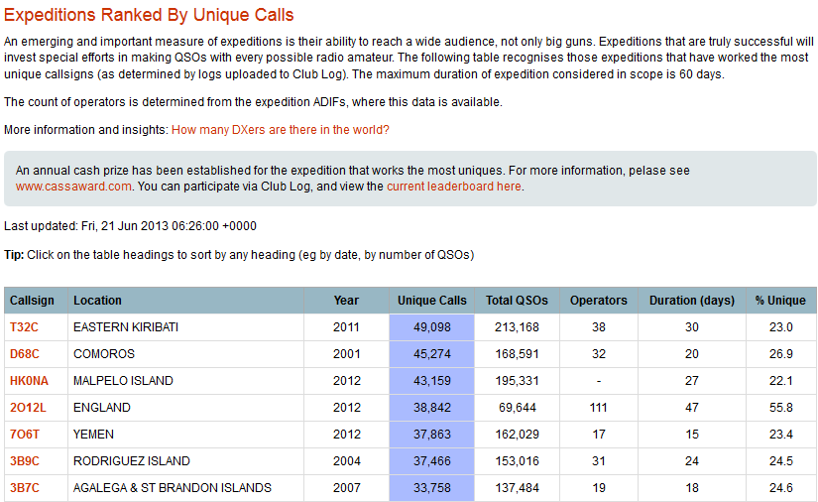
LEAGUE TABLES: Unique

Slide 43
TOOLS: DXCC WANTED LIST
  RANK ENTITITY NAME % USERS
  1. KP1 NAVASSA ISLAND 87.89
  2. P5 DPRK (NORTH KOREA) 86.79
  3. 3Y/B BOUVET ISLAND 83.82
  4. VP8S SOUTH SANDWICH ISLANDS 83.34
  5. FT5W CROZET ISLAND 83.04
  6. FT5Z AMSTERDAM & ST PAUL ISLANDS 82.65
  7. VK0H HEARD ISLAND 82.53
  8. KH5K KINGMAN REEF 80.97
  9. FR/T TROMELIN ISLAND 80.83
  10. FR/J JUAN DE NOVA, EUROPA 80.55

Slide 44
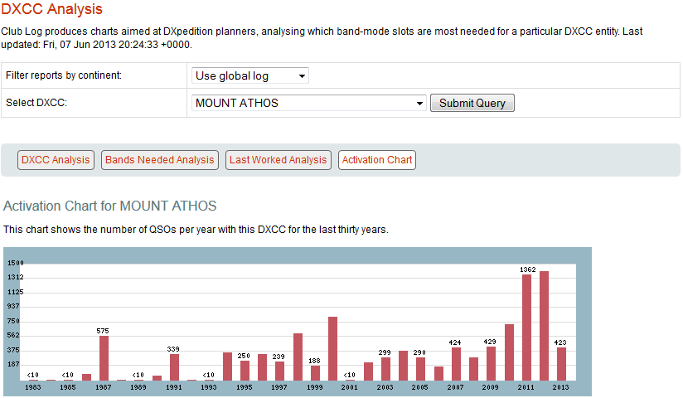
TOOLS: ANALYSIS (My Athos)

Slide 45
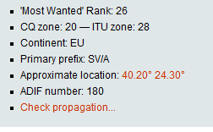
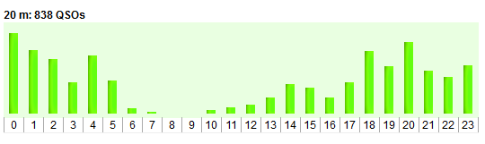
TOOLS: ANALYSIS (My Athos)
Club Log shows you how you are progressing, what you need to work, how your peers are doing…it inspires activity.
Explore the world of rare DXCC entities and gain a deeper understanding of “DX”.

Slide 46
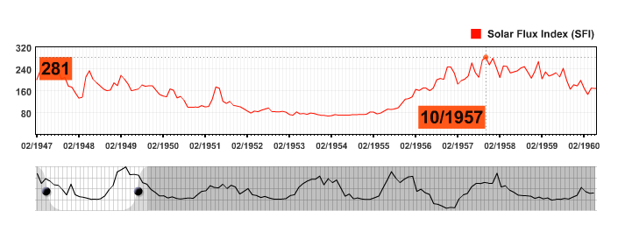
TOOLS: Propagation Charts

Slide 47
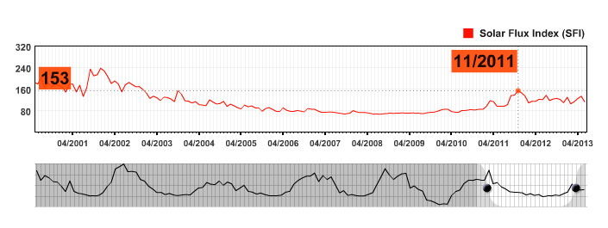
TOOLS: Propagation Charts

Slide 48
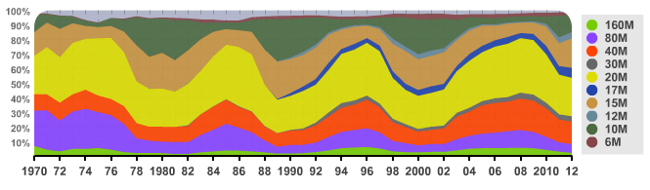
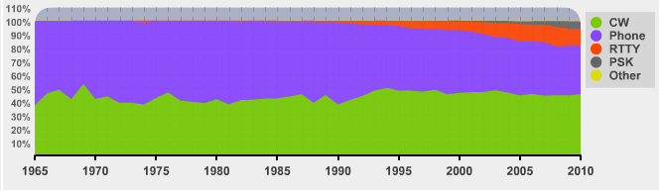
Band Activity Since 1970

Slide 49
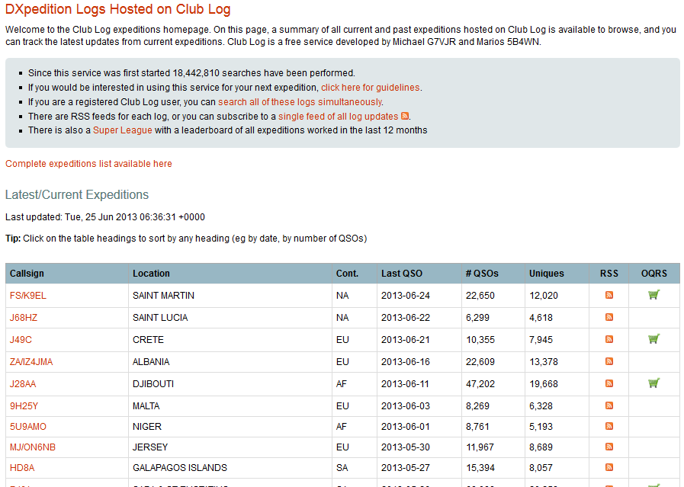
EXPEDITIONS

Slide 50
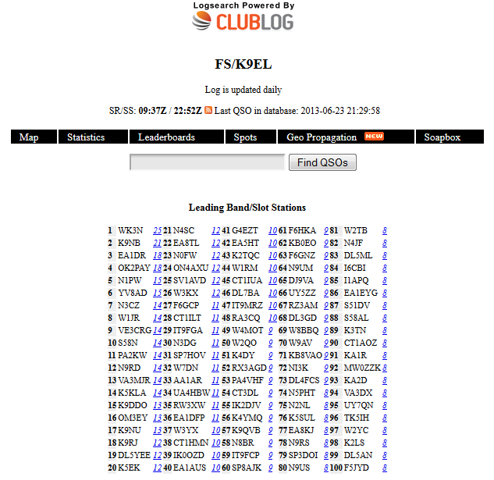

Slide 51
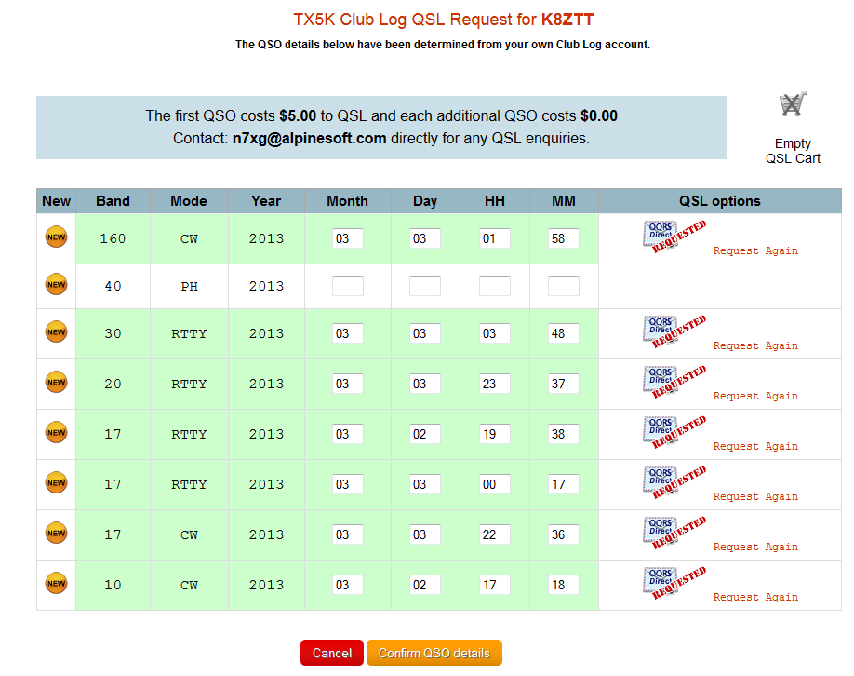
EXPEDITIONS: QSL Requests

Slide 52
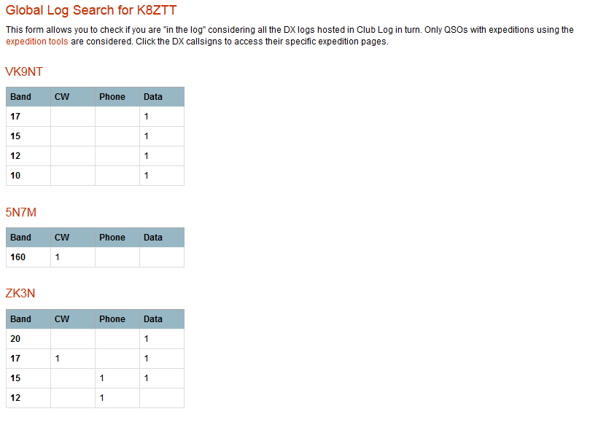
EXPEDITIONS: Log Search

Slide 53
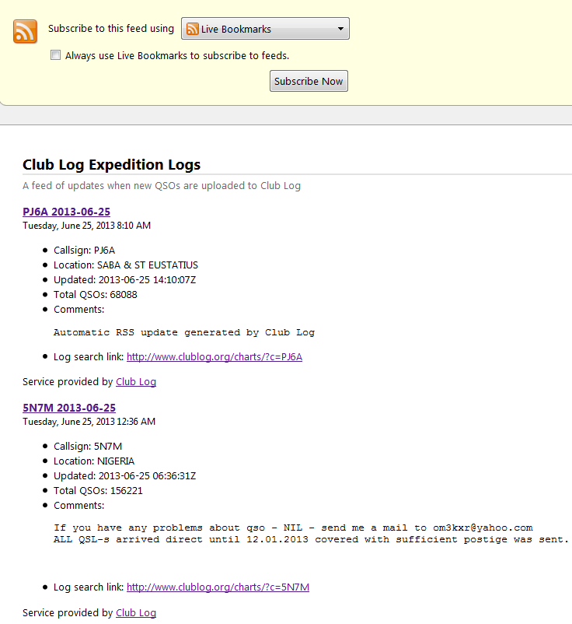
EXPEDITIONS: Feeds

Slide 54
JOIN FREE ….
www.clublog.org/signup.php

Slide 55
Club Log :: www.clublog.org
Good DX and 73 – Dick K8ZTT

